Slide 1

Task-2 - Predicting customer buying behavior
DATE:- 03/04/2023

Slide 2
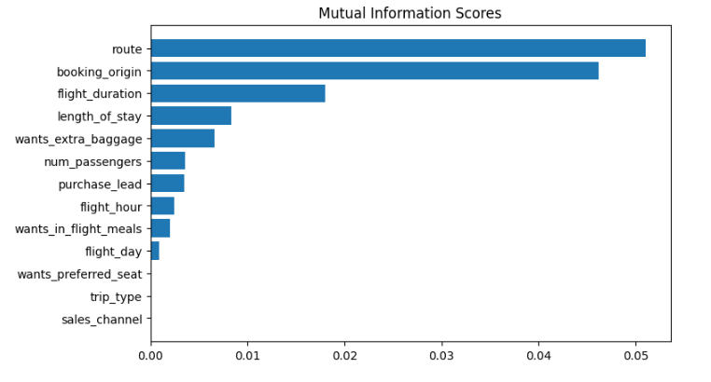
predictive model to understand factors that influence buying behavior
We Have Trained The Data Set With Random Forest Classifier Model And Received
This Are The Top 5 Features Which
Influence Customer Buying Behavior
WE NEED TO INCREASE THE AUC SCORE.
ACCURACY:-
85.09
AUC SCORE:-
0.558

